Slide 1
COMP6049 – Algorithm Design and Analysis
Topic 15-16 – Dynamic Programming: Travelling Salesman

Slide 2
Outline Materials
Traveling Salesman problem
Solving of traveling salesman problem

Slide 3
Introduction
Dynamic Programming: Travelling Salesman

Slide 4
TRAVELING SALESMAN PROBLEM
A salesman is selling his products to some addresses.
Distance inter-addresses are different.
He find a route to visit all addresses as quick as possible (shortest route), then go back to his home.
This problem is called as Traveling Salesman Problem (or TSP).

Slide 5

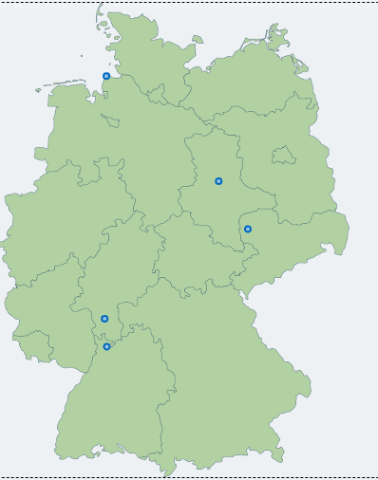
TRAVELING SALESMAN PROBLEM
Problem Example
5 number of cities
optimal tour: 1209.9 km
Source: Click Here

Slide 6
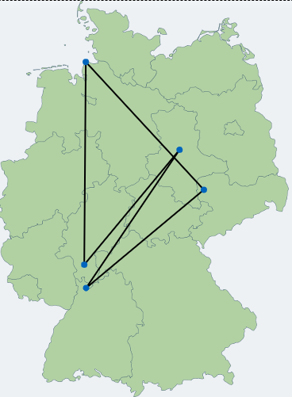
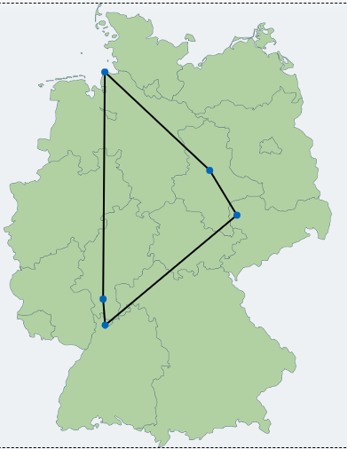


TRAVELING SALESMAN PROBLEM
Not Optimal Solution
Best Solution

Slide 7
IMPLEMENTATION OF TSP
Implementation of TSP in computer, each address is a node in graph.
Each path from an address to another is an edge that has weight.
The salesman starting his travel from a node A (his house), he MUST visit all addresses only 1 time and MUST go back to his house.

Slide 8
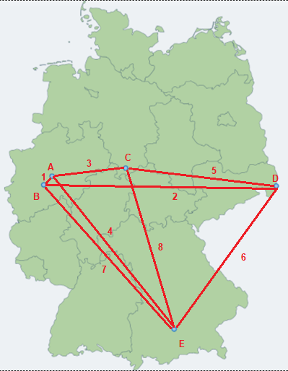
IMPLEMENTATION OF TSP
 | A | B | C | D | E
A | ∞ | 1 | 3 | ∞ | 4
B | 1 | ∞ | ∞ | 2 | 7
C | 3 | ∞ | ∞ | 5 | 8
D | ∞ | 2 | 5 | ∞ | 6
E | 4 | 7 | 8 | 6 | ∞
represented as cost matrix
(∞ is infinite)

Slide 9
Example Case
Dynamic Programming: Travelling Salesman

Slide 10
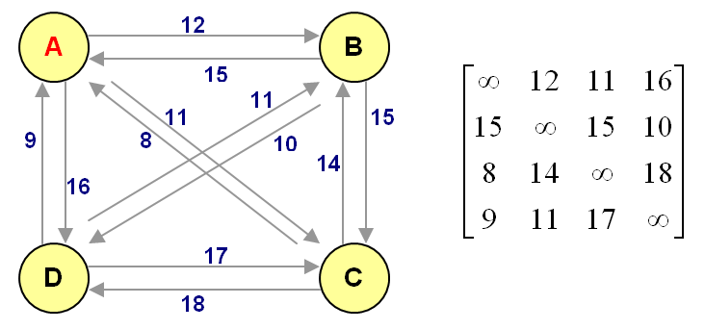
EXAMPLE CASE

Slide 11
REPRESENTATION OF TSP
We use Cost Matrix, not Adjacency Matrix, why?
If between 2 nodes does not have an edge connection, means there is no path between the nodes.
If we use 0 (zero) value in Adjacency Matrix, then Dynamic Programming algorithm will detect as shortest distance.

Slide 12
FORMULA OF TSP
Formula of Dynamic Programming in TSP
p(i,L) = min[c(j,i) + p(j,L–{j})]
Description
p(i,L) is distance of path from initial node to node i after path L.
c(j,i) is distance from node j to node i.
c(j,i) does not equal to c(i,j) because the graph contains 2 directed edges with different weight.
L-{j} is distance of path L subtracted by node j.
Then, the shortest path for the graph is p(A,{B,C,D}) that means distance of path from intial node A after going through node B, C, D by any sequences (found the shortest path).

Slide 13
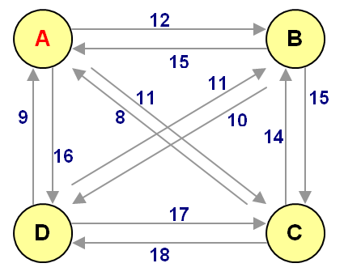
CALCULATION OF TSP
p(i,L) = min[c(j,i) + p(j,L–{j})]
p(B,Ø)=c(A,B)=12
p(C,Ø)=c(A,C)=11
p(D,Ø)=c(A,D)=16

Slide 14
CALCULATION OF TSP
p(i,L) = min[c(j,i) + p(j,L–{j})]
p(B,Ø)=c(A,B)=12
p(C,Ø)=c(A,C)=11
p(D,Ø)=c(A,D)=16
p(B,{C})=c(C,B)+p(C,Ø)
=14 +11 =25
p(B,{D})=c(D,B)+p(D,Ø)
=11 +16 =27
p(C,{B})=c(B,C)+p(B,Ø)=27
p(C,{D})=c(D,C)+p(D,Ø)=33
p(D,{B})=c(B,D)+p(B,Ø)=22
p(D,{C})=c(C,D)+p(C,Ø)=29

Slide 15
CALCULATION OF TSP
p(i,L) = min[c(j,i) + p(j,L–{j})]
p(B,{C})=c(C,B)+p(C,Ø)=25
p(B,{D})=c(D,B)+p(D,Ø)=27
p(C,{B})=c(B,C)+p(B,Ø)=27
p(C,{D})=c(D,C)+p(D,Ø)=33
p(D,{B})=c(B,D)+p(B,Ø)=22
p(D,{C})=c(C,D)+p(C,Ø)=29
p(B,{C,D})= min[c(C,B)+p(C,{D})|c(D,B)+p(D,{C})]
= min[14+33|11+29] = 40
p(C,{B,D})= min[c(B,C)+p(B,{D})|c(D,C)+p(D,{B})]
= min[15+27|17+22] = 39
p(D,{B,C})= min[c(B,D)+p(B,{C})|c(C,D)+p(C,{B})]
= min[10+25|18+27] = 35

Slide 16
CALCULATION OF TSP
p(i,L) = min[c(j,i) + p(j,L–{j})]
p(B,Ø)=c(A,B)=12
p(C,Ø)=c(A,C)=11
p(D,Ø)=c(A,D)=16
p(B,{C})=c(C,B)+p(C,Ø)=25
p(B,{D})=c(D,B)+p(D,Ø)=27
p(C,{B})=c(B,C)+p(B,Ø)=27
p(C,{D})=c(D,C)+p(D,Ø)=33
p(D,{B})=c(B,D)+p(B,Ø)=22
p(D,{C})=c(C,D)+p(C,Ø)=29
p(B,{C,D})= min[c(C,B)+p(C,{D})|c(D,B)+p(D,{C})]
= min[14+33|11+29] = 40
p(C,{B,D})= min[c(B,C)+p(B,{D})|c(D,C)+p(D,{B})]
= min[15+27|17+22] = 39
p(D,{B,C})= min[c(B,D)+p(B,{C})|c(C,D)+p(C,{B})]
= min[10+25|18+27] = 35
p(A,{B,C,D})= min[c(B,A)+p(B,{C,D})|
c(C,A)+p(C,{B,D})|
c(D,A)+p(D,{B,C})]
= min[15+40|8+39|9+35]
= 44
Distance of the shortest path = 44

Slide 17
EXERCISE
Given a Cost Matrix of TSP as:
Depict the TSP Graph!
Find the shortest path of TSP using Dynamic Programming !

Slide 18
Q & A

Slide 19
References
S. Sridhar. 2014. Design and Analysis of Algorithms, 1/e. Oxford University Press. India. Chapter 13
Ellis Horowitz,Sanguthevar Rajasekaran,Sartaj Sahni. 1998. Computer algorithms/C++. 1STBL. New York. Chapter 5.9
The Traveling Salesman Problem http://www.csd.uoc.gr/~hy583/papers/ch11.pdf

Slide 20
THANK YOU

Slide 21
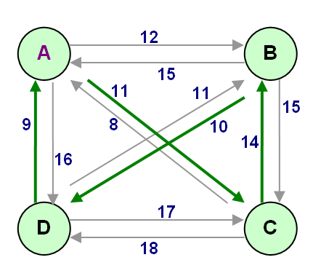
CALCULATION OF TSP
p(B,Ø)=c(A,B)=12
p(C,Ø)=c(A,C)=11
p(D,Ø)=c(A,D)=16
p(B,{C})=c(C,B)+p(C,Ø)=25
p(B,{D})=c(D,B)+p(D,Ø)=27
p(C,{B})=c(B,C)+p(B,Ø)=29
p(C,{D})=c(D,C)+p(D,Ø)=33
p(D,{B})=c(B,D)+p(B,Ø)=22
p(D,{C})=c(C,D)+p(C,Ø)=29
p(B,{C,D})= min[c(C,B)+p(C,{D})|c(D,B)+p(D,{C})]
= min[14+33|11+29] = 40
p(C,{B,D})= min[c(B,C)+p(B,{D})|c(D,C)+p(D,{B})]
= min[15+27|17+22] = 39
p(D,{B,C})= min[c(B,D)+p(B,{C})|c(C,D)+p(C,{B})]
= min[10+25|18+27] = 35
p(A,{B,C,D})= min[c(B,A)+p(B,{C,D})|
c(C,A)+p(C,{B,D})|
c(D,A)+p(D,{B,C})]
= min[15+40|8+39|9+35]
= 44
The shortest path = ACBDA

Slide 22
Initial Node = A
p(B,Ø) = c(A,B) = 17
p(C,Ø) = c(A,C) = 999
p(D,Ø) = c(A,D) = 8
p(E,Ø) = c(A,E) = 12
p(B,{C})=c(C,B)+p(C,Ø)=16+999 =999
p(B,{D})=c(D,B)+p(D,Ø)=19+8 =27
p(B,{E})=c(E,B)+p(E,Ø)=7+12 =19
p(C,{B})=c(B,C)+p(B,Ø)=15+17 =32
p(C,{D})=c(D,C)+p(D,Ø)=10+8 =18
p(C,{E})=c(E,C)+p(E,Ø)=19+12 =31
p(D,{B})=c(B,D)+p(B,Ø)=11+17 =28
p(D,{C})=c(C,D)+p(C,Ø)=9+999 =999
p(D,{E})=c(E,D)+p(E,Ø)=999+12 =999
p(E,{B})=c(B,E)+p(B,Ø)=14+17 =31
p(E,{C})=c(C,E)+p(C,Ø)=10+999 =999
p(E,{D})=c(D,E)+p(D,Ø)=13+8 =21
p(B,{C,D,E}) = min[
c(C,B) + p(C,{D}) |
c(D,B) + p(D,{C}) |
c(E,B) + ?]
= min[?+?|?+?] = ?
p(C,{B,D})= min[c(B,C)+p(B,{D})|c(D,C)+p(D,{B})]
= min[15+27|17+22] = 39
p(D,{B,C})= min[c(B,D)+p(B,{C})|c(C,D)+p(C,{B})]
= min[10+25|18+27] = 35
A B C D E
A
B
C
D
E

Slide 23
REVIEW
TRAVELING SALESMAN PROBLEM
IMPLEMENTATION OF TSP
REPRESENTATION OF TSP
FORMULA OF TSP
Calculation of TSP
Shortest path of TSP

